Slide 1
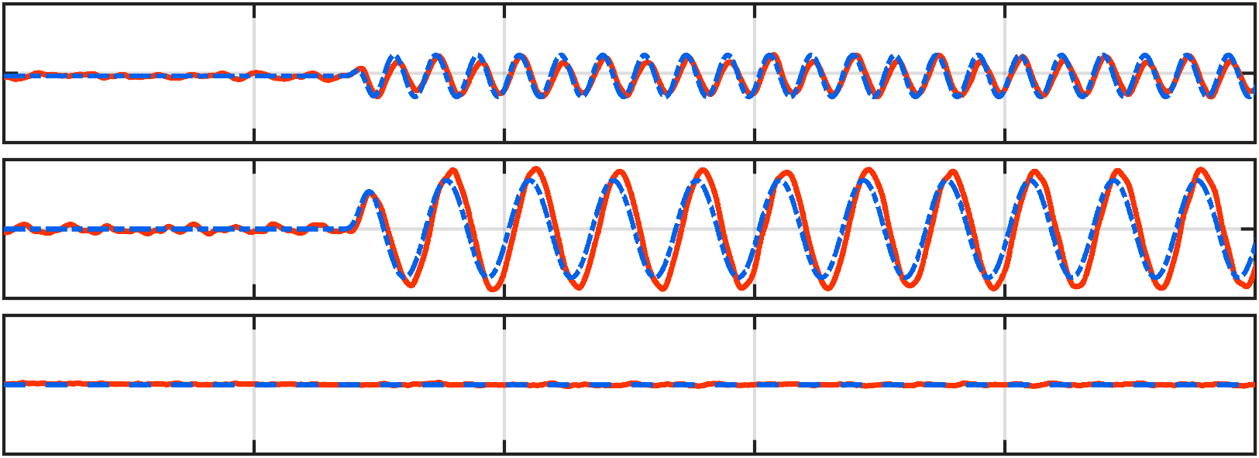
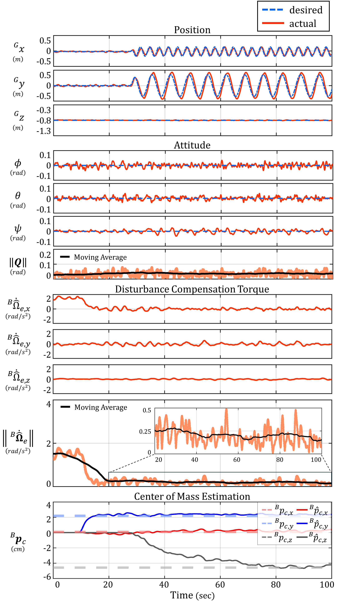
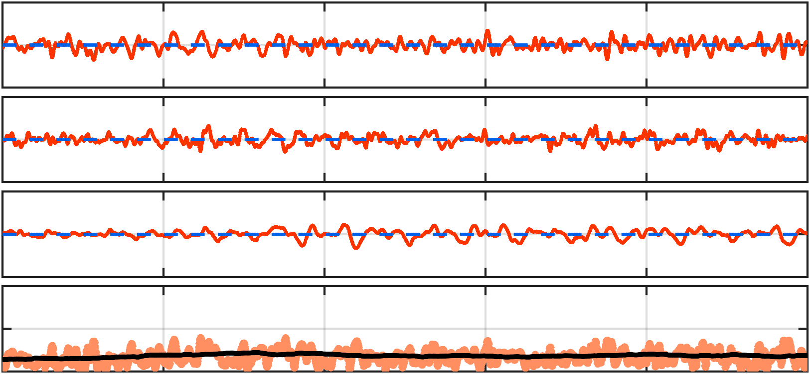
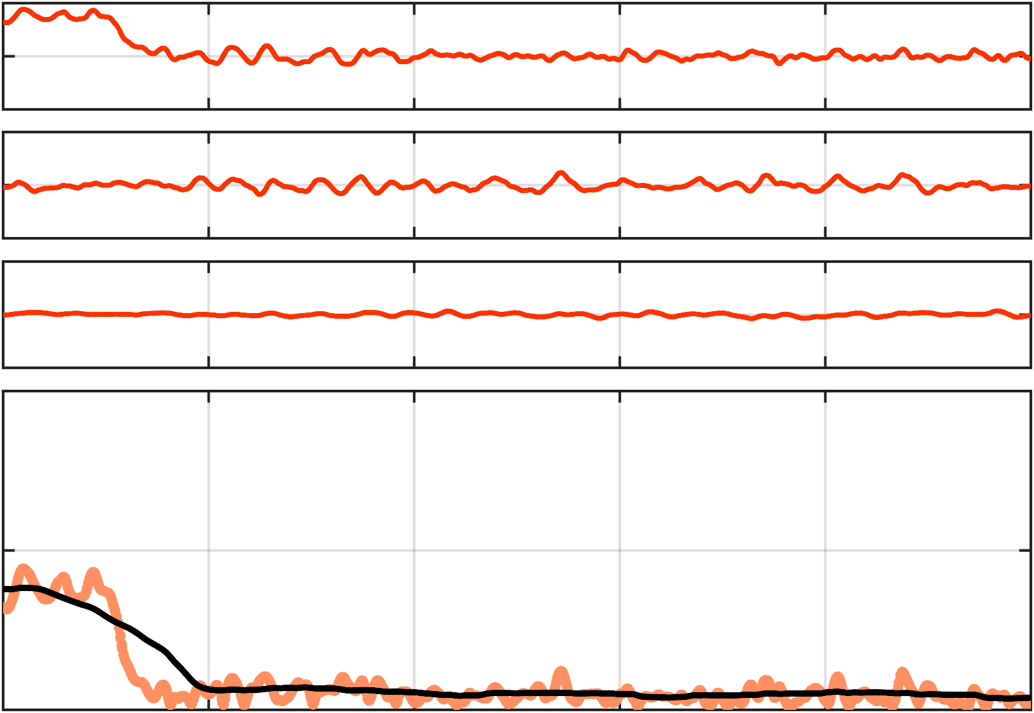
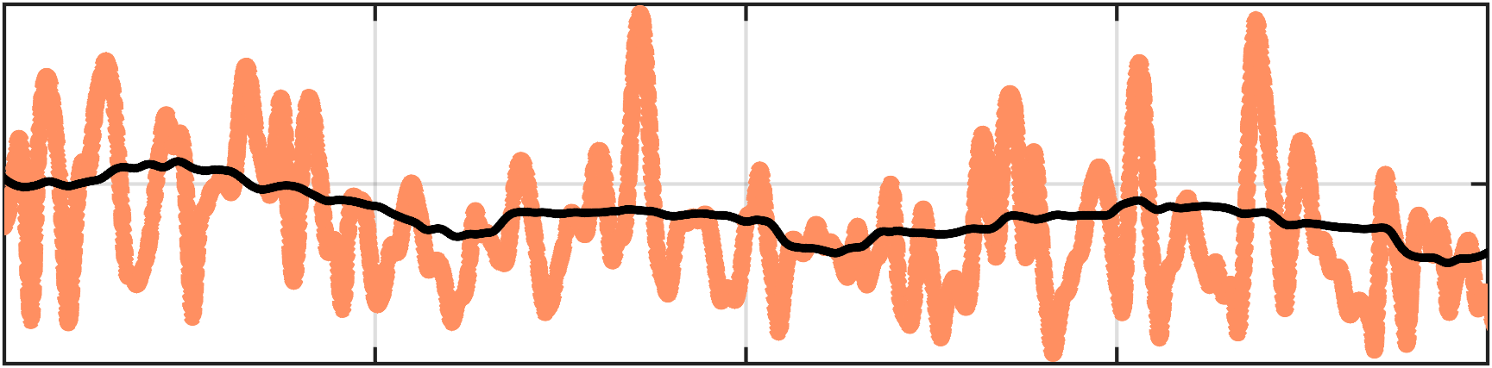
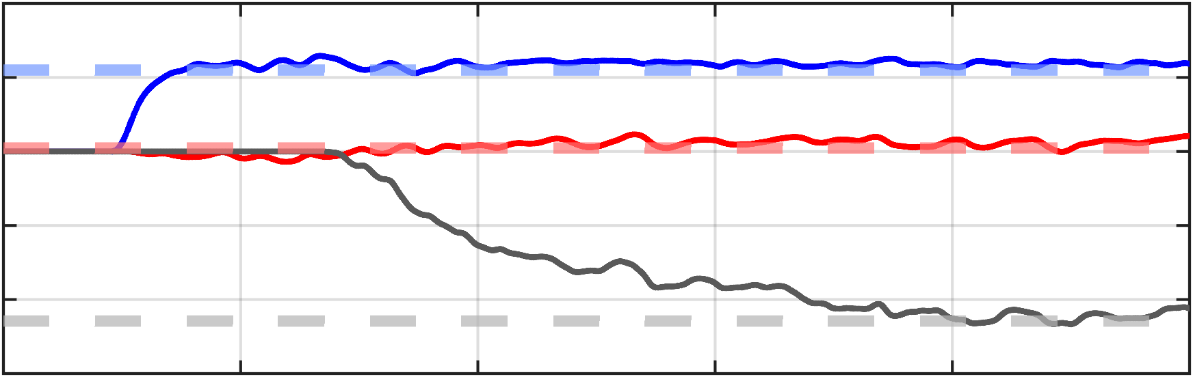
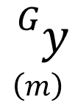
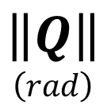
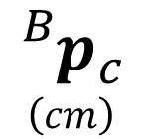

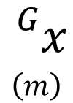
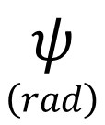
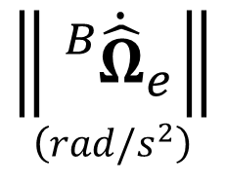
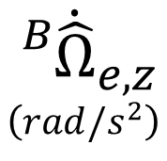

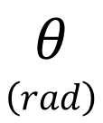

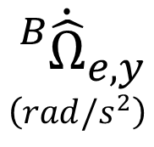

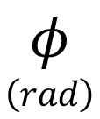


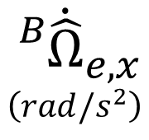

desired
0.5
Position
actual
$${}_{}^{G}x \\ \left(m\right)$$
0
-0.5
$${}_{}^{G}y \\ \left(m\right)$$
0.5
0
-0.5
$${}_{}^{G}z \\ \left(m\right)$$
-0.3
-0.8
-1.3
Attitude
$$φ \\ \left(rad\right)$$
0.1
0
-0.1
$$θ \\ \left(rad\right)$$
0.1
0
-0.1
$$ψ \\ \left(rad\right)$$
0.1
0
-0.1
$$\left\|Q\right\| \\ \left(rad\right)$$
0.2
Moving Average
0.1
0
Disturbance Compensation Torque
$${}_{}^{B}{{\dot{\hat{Ω}}}_{e,x}} \\ \left(rad/s^{2}\right)$$
2
0
-2
$${}_{}^{B}{{\dot{\hat{Ω}}}_{e,y}} \\ \left(rad/s^{2}\right)$$
2
0
-2
$${}_{}^{B}{{\dot{\hat{Ω}}}_{e,z}} \\ \left(rad/s^{2}\right)$$
2
0
-2
4
Moving Average
0.5
$$\left\|{}_{}^{B}{{\dot{\hat{Ω}}}_{e}}\right\| \\ \left(rad/s^{2}\right)$$
2
0.25
0
20
40
60
80
100
0
Center of Mass Estimation
4
$${}_{}^{B}{p_{c,x}}$$
$${}_{}^{B}{{\hat{p}}_{c,x}}$$
2
$${}_{}^{B}{p_{c,y}}$$
$${}_{}^{B}{{\hat{p}}_{c,y}}$$
$${}_{}^{B}{p_{c }} \\ \left(cm\right)$$
0
$${}_{}^{B}{p_{c,z}}$$
$${}_{}^{B}{{\hat{p}}_{c,z}}$$
-2
-4
-6
0
20
40
60
80
100
Time (sec)

Slide 2
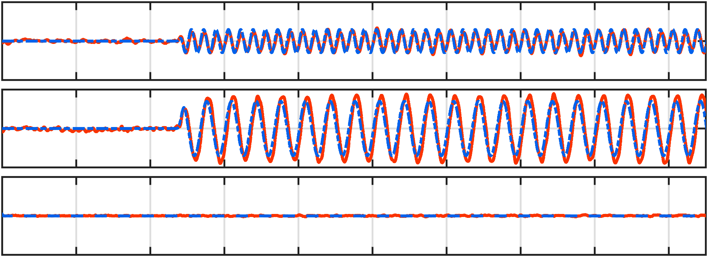
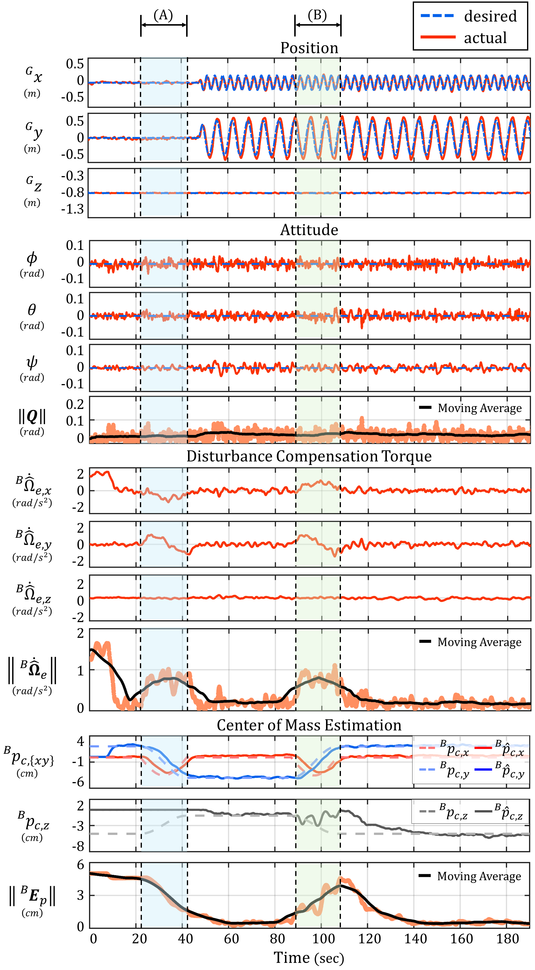
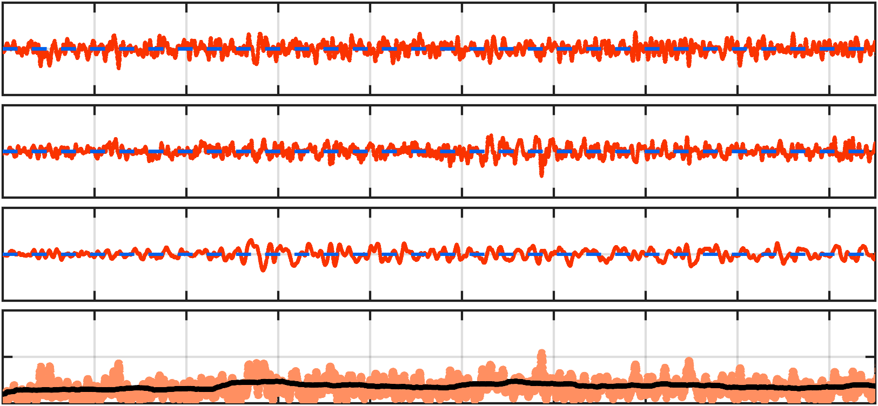
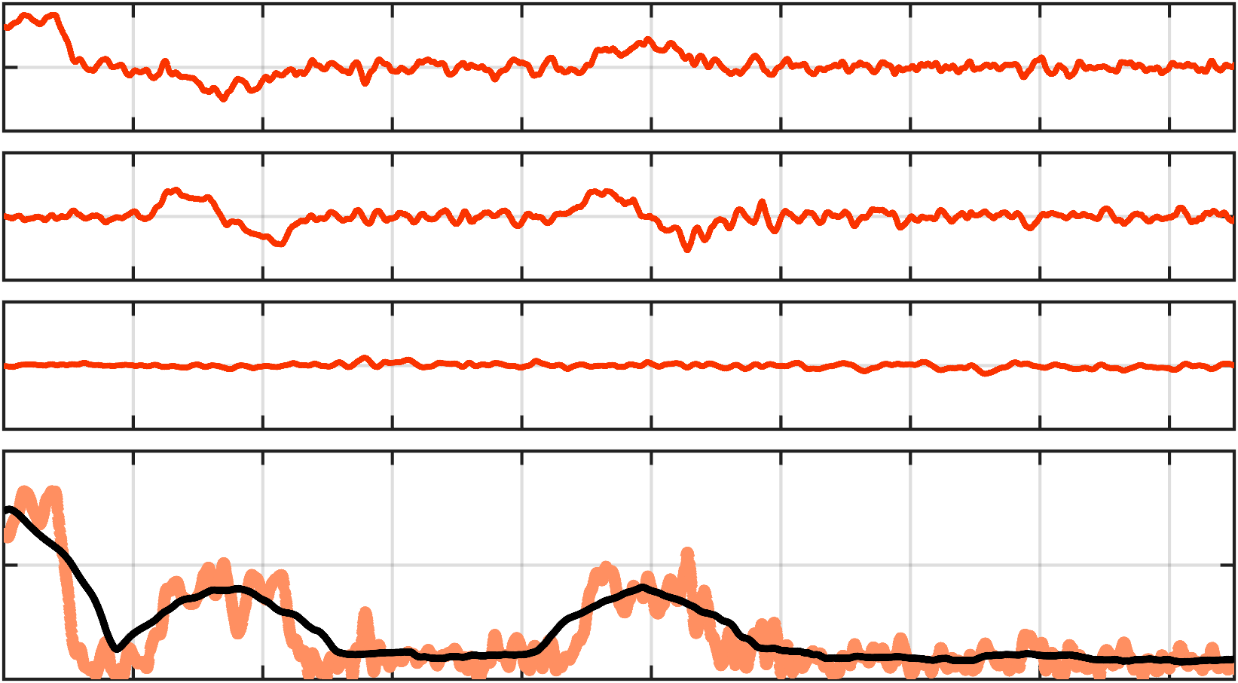
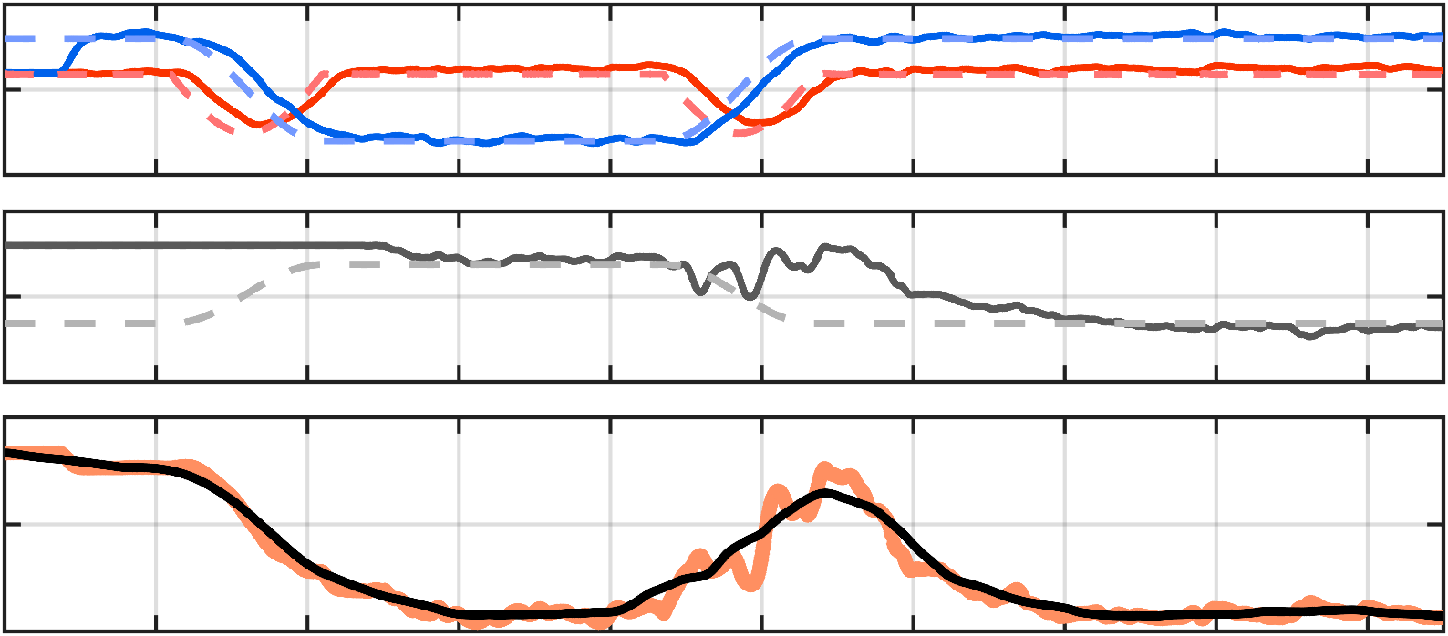


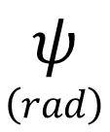




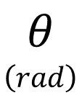

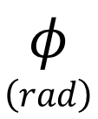




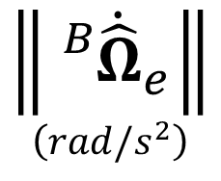

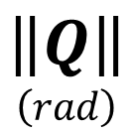



(A)
(B)
desired
0.5
Position
actual
$${}_{}^{G}x \\ \left(m\right)$$
0
-0.5
$${}_{}^{G}y \\ \left(m\right)$$
0.5
0
-0.5
$${}_{}^{G}z \\ \left(m\right)$$
-0.3
-0.8
-1.3
Attitude
$$φ \\ \left(rad\right)$$
0.1
0
-0.1
$$θ \\ \left(rad\right)$$
0.1
0
-0.1
$$ψ \\ \left(rad\right)$$
0.1
0
-0.1
$$\left\|Q\right\| \\ \left(rad\right)$$
0.2
Moving Average
0.1
0
Disturbance Compensation Torque
$${}_{}^{B}{{\dot{\hat{Ω}}}_{e,x}} \\ \left(rad/s^{2}\right)$$
2
0
-2
$${}_{}^{B}{{\dot{\hat{Ω}}}_{e,y}} \\ \left(rad/s^{2}\right)$$
2
0
-2
$${}_{}^{B}{{\dot{\hat{Ω}}}_{e,z}} \\ \left(rad/s^{2}\right)$$
2
0
-2
$$\left\|{}_{}^{B}{{\dot{\hat{Ω}}}_{e}}\right\| \\ \left(rad/s^{2}\right)$$
2
Moving Average
1
0
Center of Mass Estimation
$${}_{}^{B}{p_{c,\left\{xy\right\}}} \\ \left(cm\right)$$
4
$${}_{}^{B}{p_{c,x}}$$
$${}_{}^{B}{{\hat{p}}_{c,x}}$$
-1
$${}_{}^{B}{p_{c,y}}$$
$${}_{}^{B}{{\hat{p}}_{c,y}}$$
-6
$${}_{}^{B}{p_{c,z}} \\ \left(cm\right)$$
2
$${}_{}^{B}{p_{c,z}}$$
$${}_{}^{B}{{\hat{p}}_{c,z}}$$
-3
-8
$$\left\|{}_{}^{B}{E_{p}}\right\| \\ \left(cm\right)$$
6
Moving Average
3
0
0
20
40
60
80
100
120
140
160
180
Time (sec)
Notes:
피피티 통째로 보내줘 카톡으로!

Slide 3
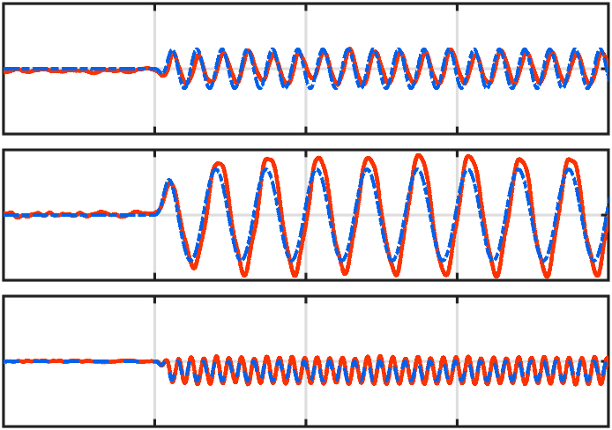
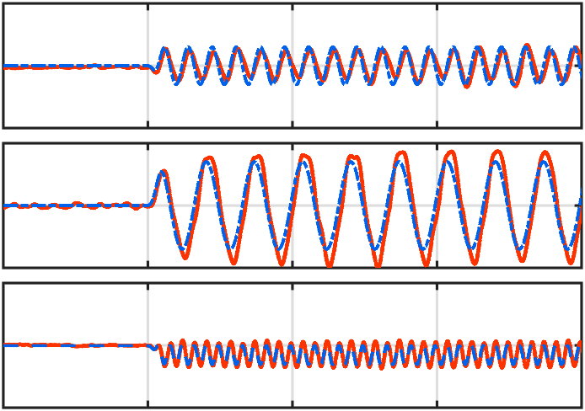
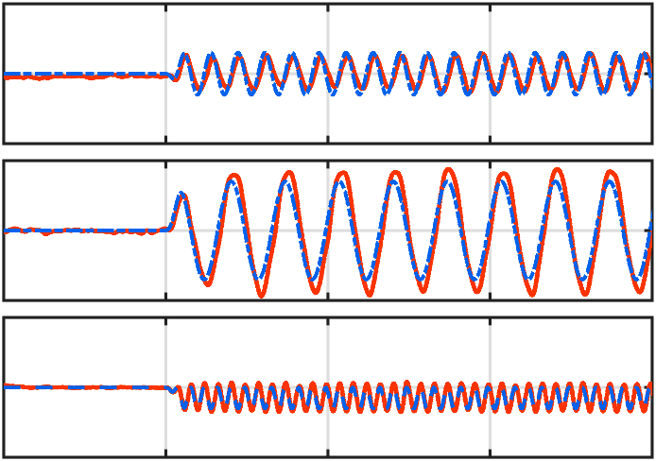
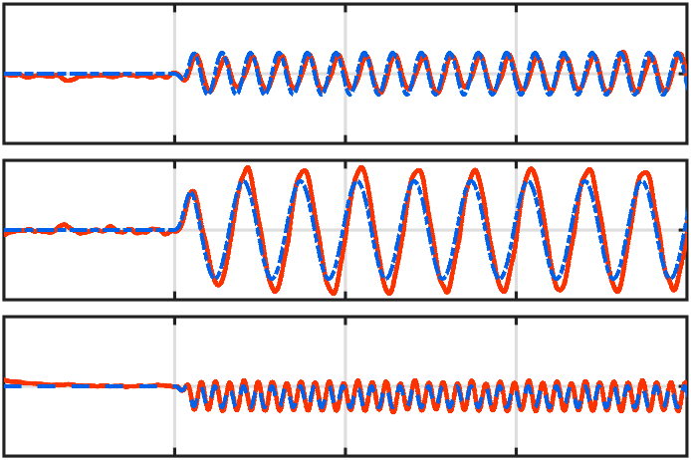
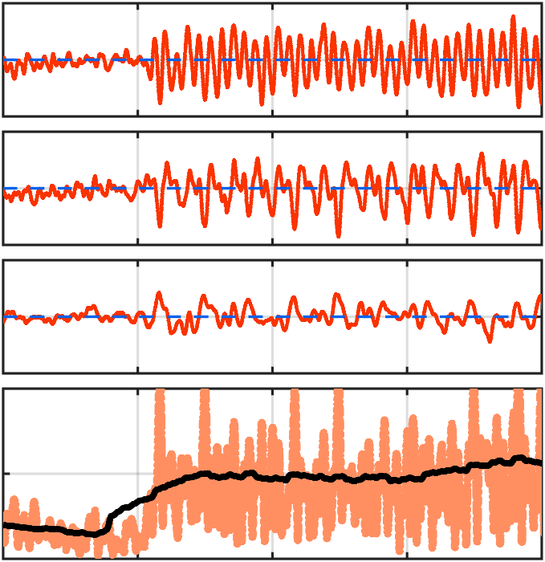
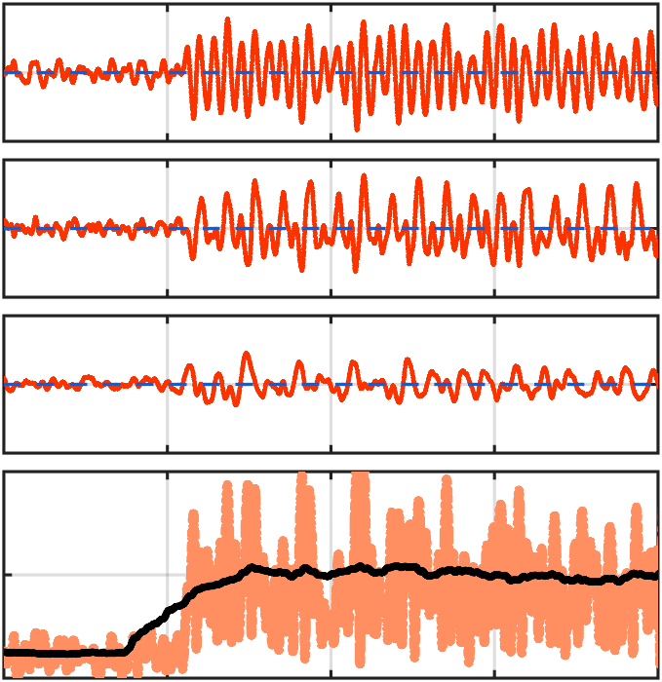
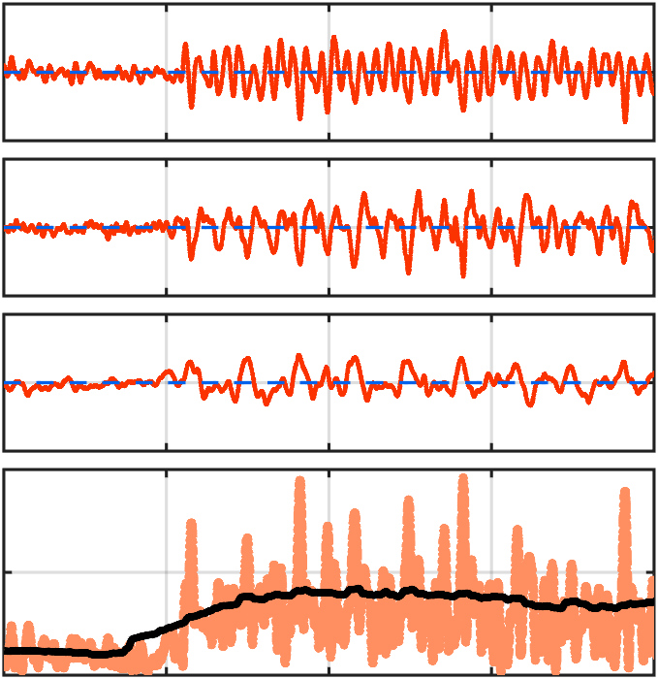
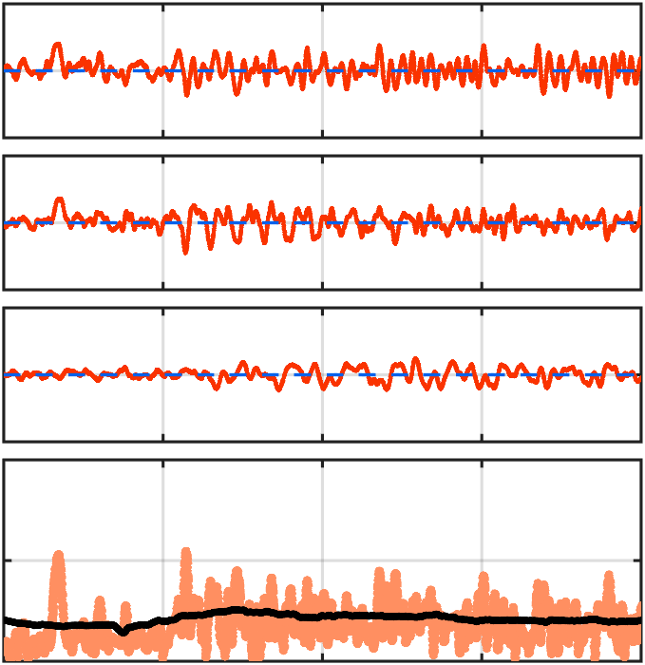
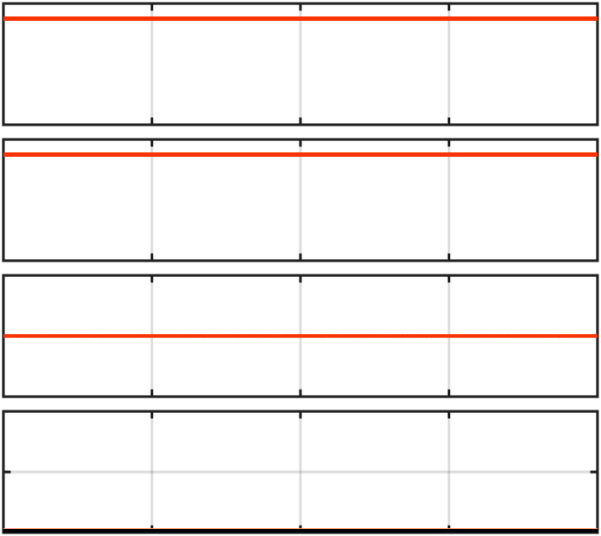
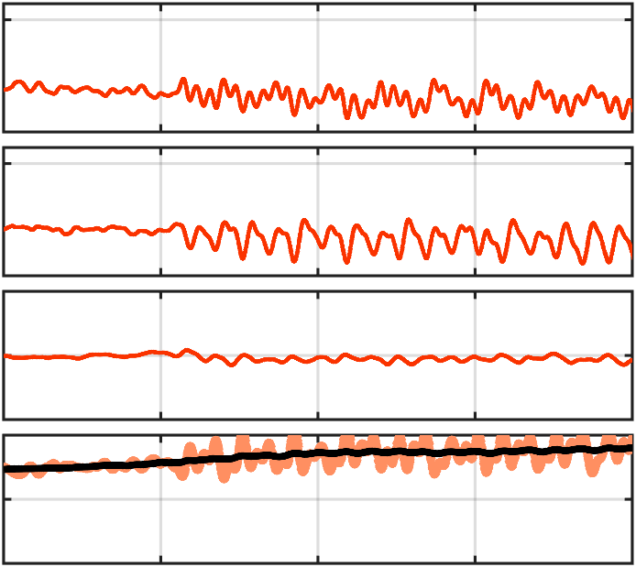
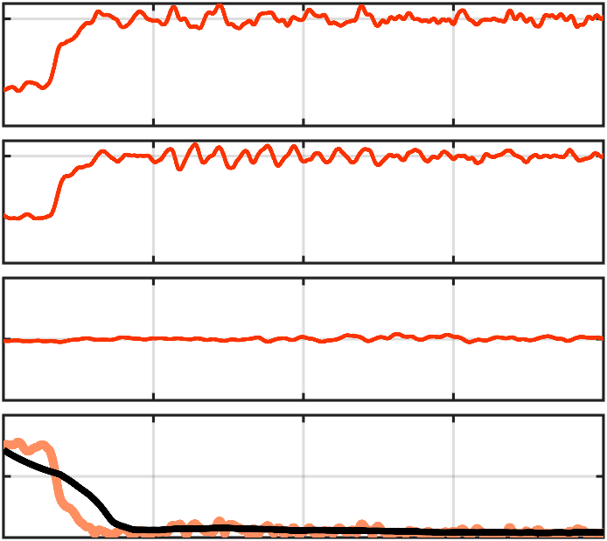
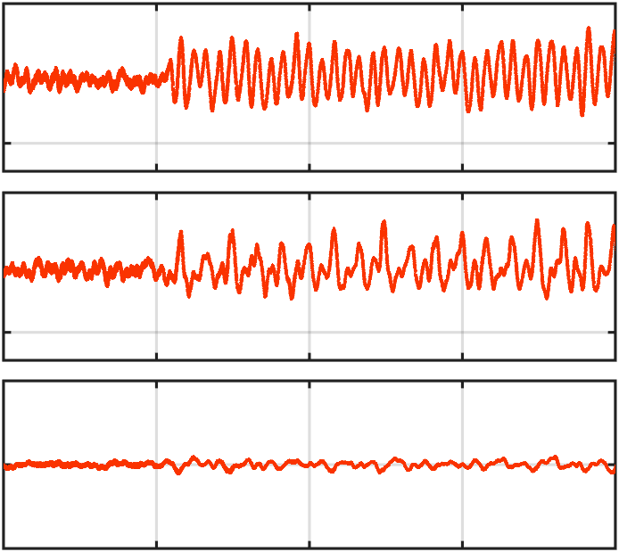
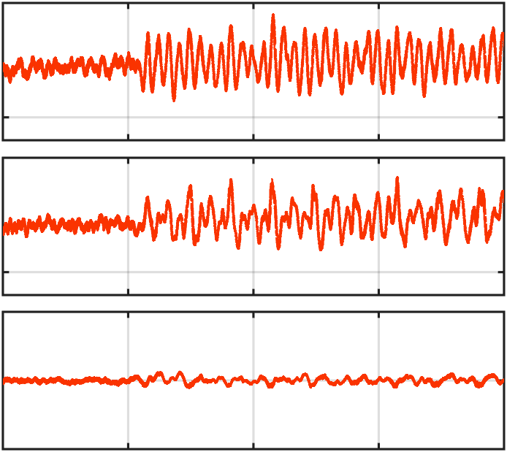
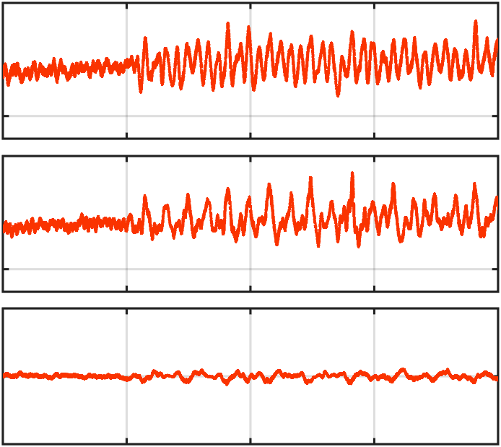
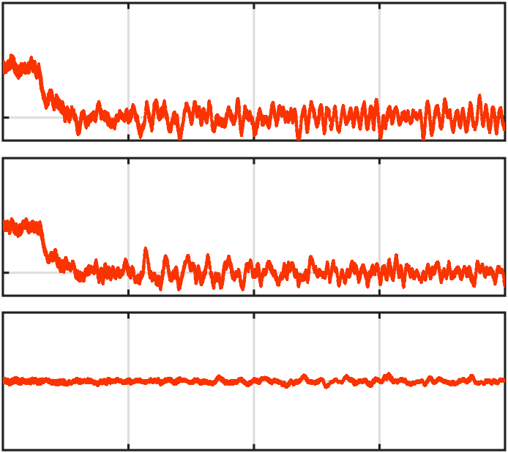

























desired
Baseline PID
Robust Control
Robust Adaptive Control
actual
$${}_{}^{G}x \\ \left(m\right)$$
0.5
Proposed MOCE 2.0
0
-0.5
$${}_{}^{G}y \\ \left(m\right)$$
0.5
Position
0
-0.5
$${}_{}^{G}z \\ \left(m\right)$$
-0.2
-0.7
-1.2
$$φ \\ \left(rad\right)$$
0.1
0
-0.1
$$θ \\ \left(rad\right)$$
0.1
0
-0.1
Attitude
$$ψ \\ \left(rad\right)$$
0.1
0
-0.1
$$\left\|Q\right\| \\ \left(rad\right)$$
0.1
0.05
0
Moving Average
Moving Average
Moving Average
Moving Average
$${}_{}^{B}{{\dot{\hat{Ω}}}_{e,x}} \\ \left(rad/s^{2}\right)$$
0
-3.5
$${}_{}^{B}{{\dot{\hat{Ω}}}_{e,y}} \\ \left(rad/s^{2}\right)$$
0
N/A
N/A
-3.5
Disturbance Torque
$${}_{}^{B}{{\dot{\hat{Ω}}}_{e,z}} \\ \left(rad/s^{2}\right)$$
2
0
-2
$$\left\|{}_{}^{B}{{\dot{\hat{Ω}}}_{e}}\right\| \\ \left(rad/s^{2}\right)$$
4
2
0
Moving Average
Moving Average
5
$${}_{}^{B}{{\dot{Ω}}_{d,x}} \\ \left(rad/s^{2}\right)$$
0
5
$${}_{}^{B}{{\dot{Ω}}_{d,y}} \\ \left(rad/s^{2}\right)$$
Desired Torque
0
3
$${}_{}^{B}{{\dot{Ω}}_{d,z}} \\ \left(rad/s^{2}\right)$$
0
-3
4
$${}_{}^{B}{p_{c,x}}$$
$${}_{}^{B}{{\hat{p}}_{c,x}}$$
2
$${}_{}^{B}{p_{c,y}}$$
$${}_{}^{B}{{\hat{p}}_{c,y}}$$
$${}_{}^{B}{p_{c }} \\ \left(cm\right)$$
0
N/A
N/A
$${}_{}^{B}{p_{c,z}}$$
$${}_{}^{B}{{\hat{p}}_{c,z}}$$
CoM Estimation
-2
-4
-6
0
20
40
60
80
0
20
40
60
80
0
20
40
60
80
0
20
40
60
80
Time (sec)
Time (sec)
Time (sec)
Time (sec)

